Slide 1
Sparse Score Fusion for Classifying Mate Pairs of Images
Challenge MDI343 2017-2018
Kaichen MA

Slide 2
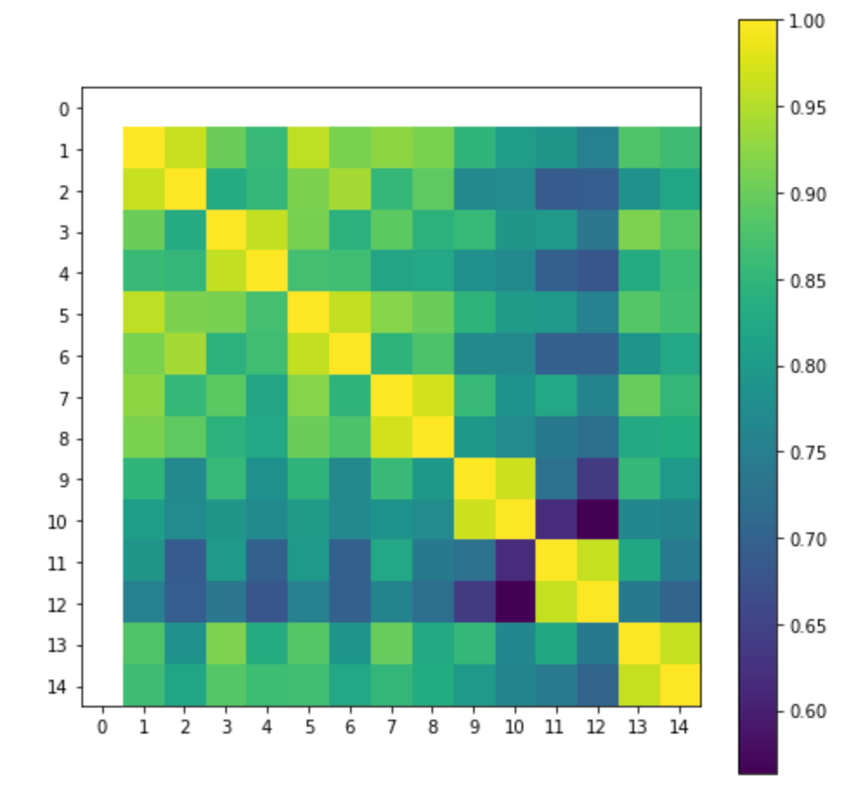
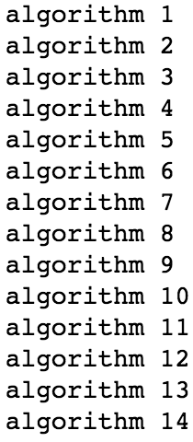
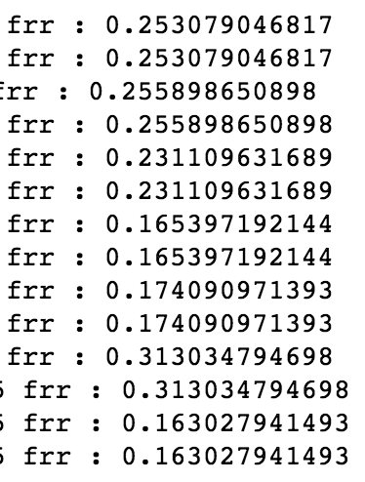
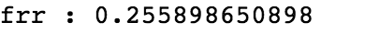
Feature analysis and comparisons
performance of each algorithm
correlation among algorithms
These pair algorithms are relatively correlated: Algo1 and 2, Algo3 and 4, algo5 and 6, Algo7 and 8, Algo9 and 10, Algo11 and 12, Algo13 and 14.
Algo 7, 8, 9, 10, 13, 14 display better performance than the others.

Slide 3
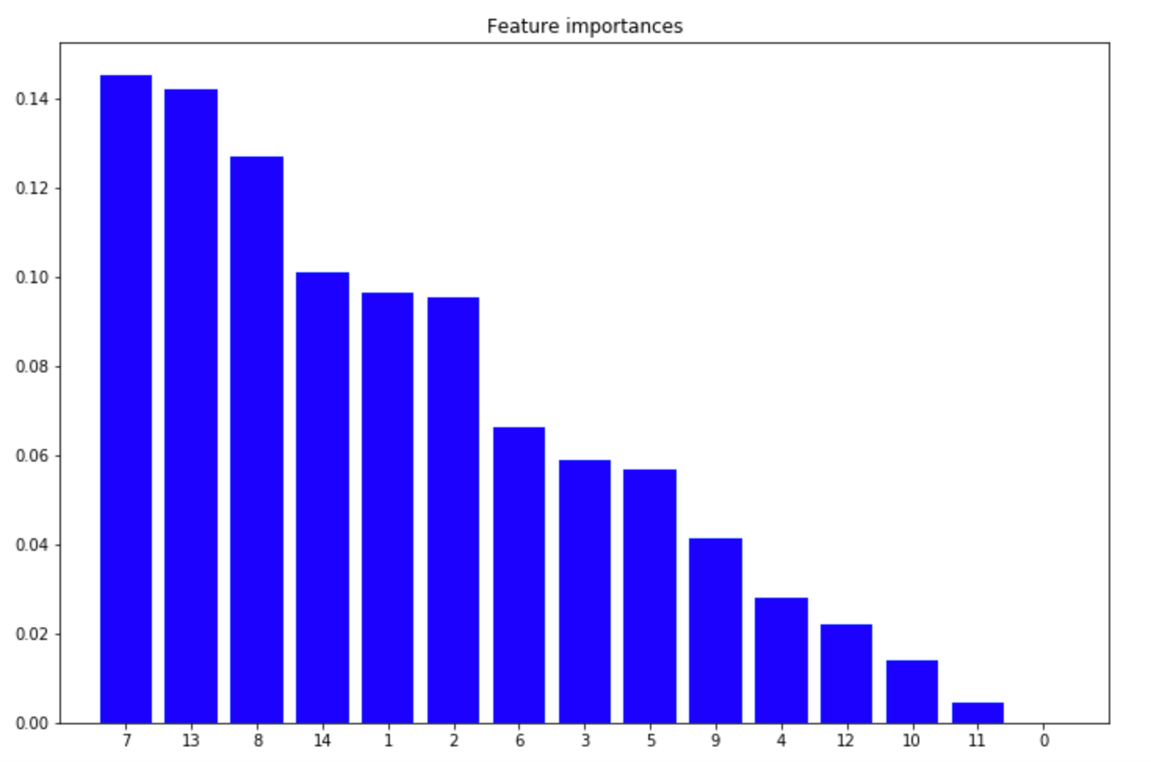
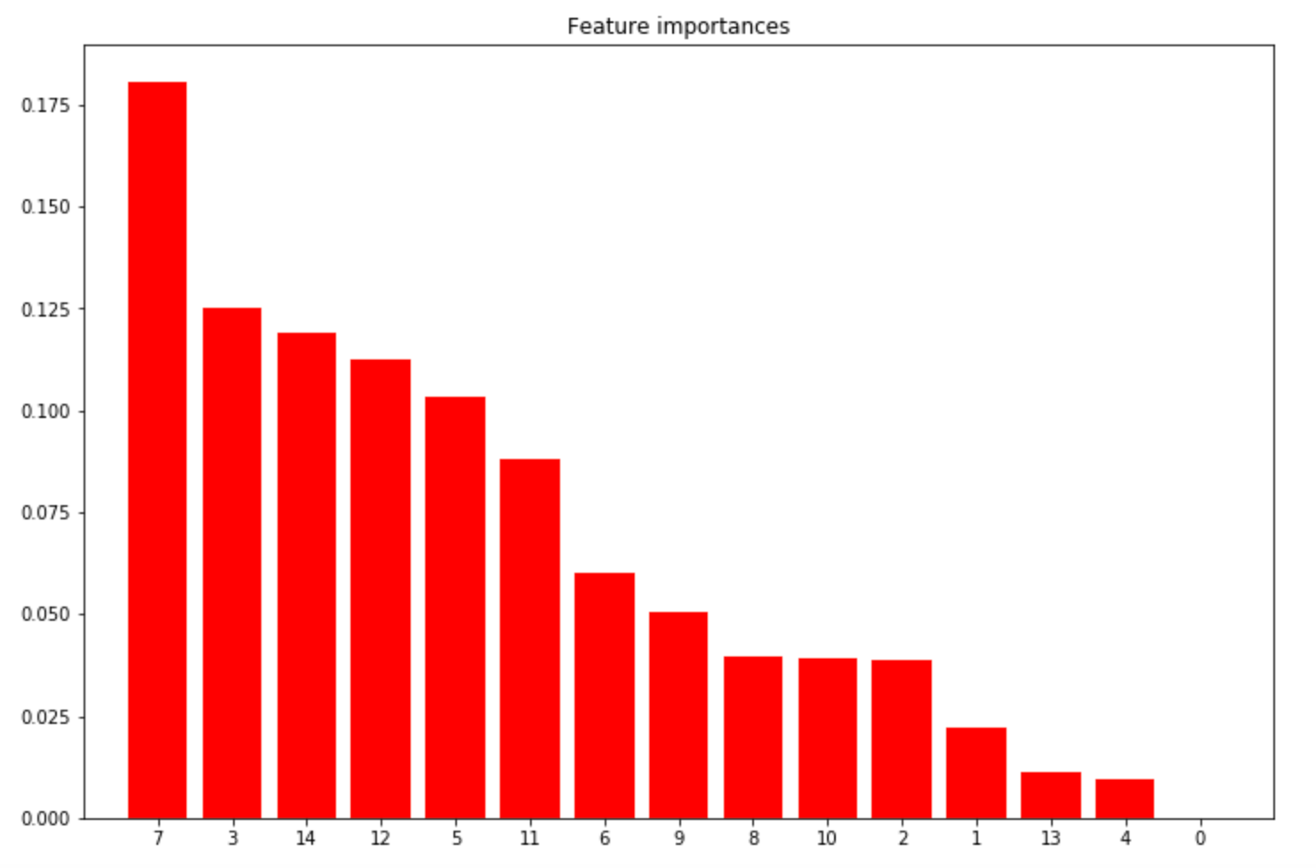
Feature analysis and comparisons
Feature importance analysis by logistic regression
Feature importance analysis by extra tree
In global, the algo 7, 8, 13, 14 are relatively having more weigh than other algorithms.
This is consistent with the algorithm's performance analysis.

Slide 4
Variable construction and processing
Enumerate all possible combinations among 14 algorithms
16384 combinations
Remove the combinations that exceed budgeted time
1024 combinations
Remove subsets in those combinations
577 combinations
Calculate false recognition rate (FRR) for each combinations
coefficents for these combinations are simply identificly given 1
Algorithm combinations are filtered according to their FRR, those with 10 least errors are selected.
The 10 top combinations are all among Algo 7 to 14.

Slide 5
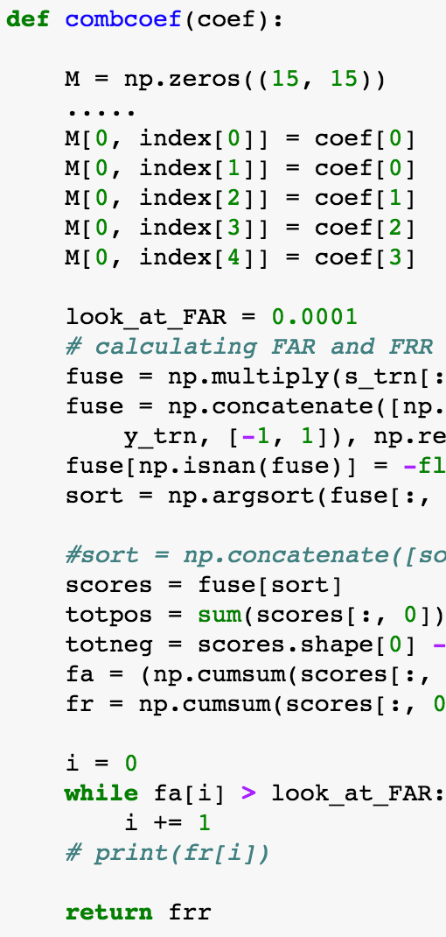
Optimization of combination coefficients
Define a function which calculates FRR with fusion matrix M
Use function minimize to optimize relative coefficients for selected combinations
Notes:
Constrained Optimization BY Linear Approximation (COBYLA)

Slide 6
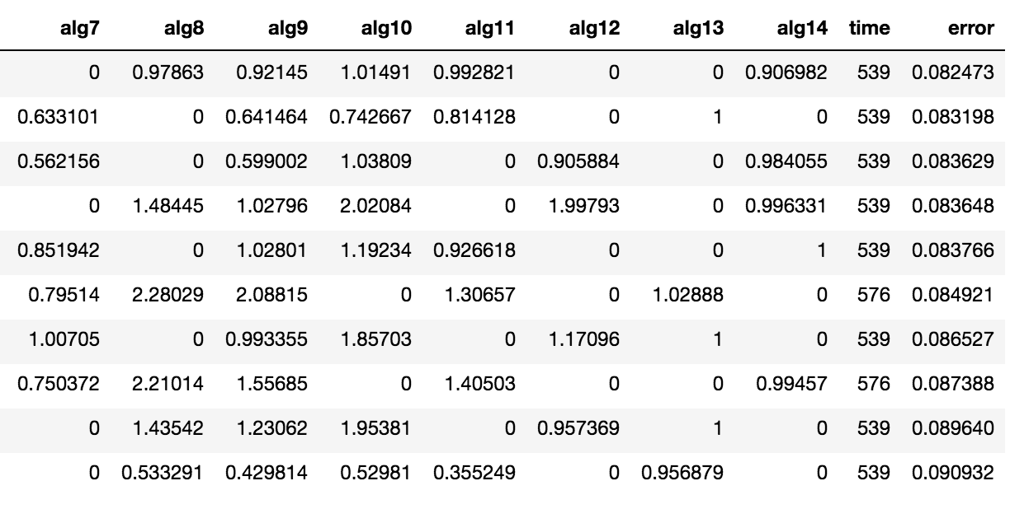
Validation and conclusion
Calculate FRR with optimized coefficients for training data
They are generally validated for training data, except the combination 3, i.e. among Algo 8, 9, 10, 11, 13.

Slide 7
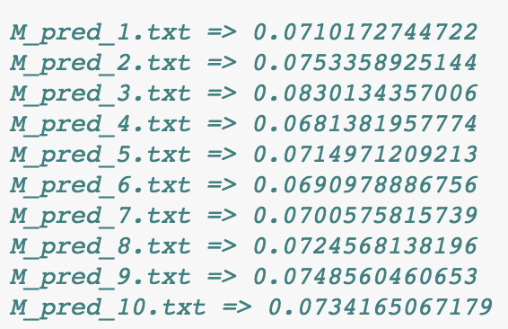
Validation and conclusion
Validate optimized coefficients by test data
Consistent with training data, algorithm combination 3 displays the worst performance of classification.
Combination 4, composed of Algo 7, 9, 10, 11, 14 has the best classification performance.

Slide 8
Thanks for your attention !

